Slide 1
?

Slide 2

Notes:
Pic scared of a goal

Slide 3


Slide 4

Two Weeks Later…

Slide 5


Slide 6

Notes:
Or even make u cry

Slide 7
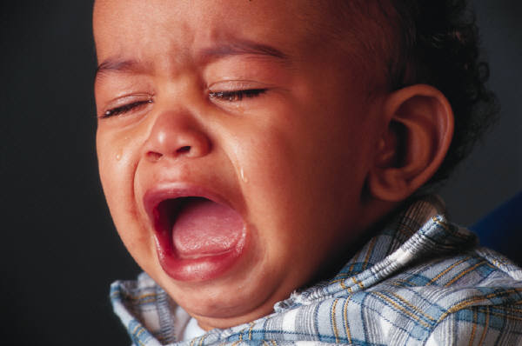

Slide 8
The Solution is here

Slide 9

Set a Goal – Reach It

